Slide 1
COMP2106 – Advanced Server Side Scripting
Lesson 3
The MEAN STACK
Node.js & NPM

Slide 2
Lesson Objectives
In this Lesson you will learn about:
Intro to the MEAN Stack
Intro to Node.js
Intro to NPM

Slide 3
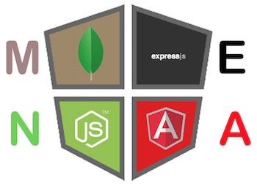
Intro to the MEAN Stack

Slide 4
Intro to the MEAN Stack
The MEAN stack is a powerful, full-stack JavaScript solution that comprises four major building blocks:
MongoDB as the database
Express as the web server framework
AngularJS as the web client framework
Node.js as the server platform.
These building blocks are being developed by different teams and involve a substantial community of developers and advocates pushing forward the development and documentation of each component.
The main strength of the stack lies in its centralization of JavaScript as the main programming language.
However, the problem of connecting these tools together can lay the foundation for scaling and architecture issues, which can dramatically affect your development process.

Slide 5
Three-tier web application development
Most modern web applications are built in a three-tier architecture that consists of three important layers:
data
logic
presentation
In web applications, the application structure usually breaks down to database, server, and client, while in modern web development, it can also be broken into database, server logic, client logic, and client UI.

Slide 6
Three-tier web application development (cont’d)
A popular paradigm of implementing this model is the MVC architectural pattern.
In the MVC paradigm, the logic, data, and visualization are separated into three types of objects, each handling its own tasks.
The Model handles data manipulation, responding to requests for information or changing its state according to the Controller's instructions.
The View handles the visual part, taking care of user interaction.
The Controller responds to system and user events, commanding the Model and View to change appropriately.
A simple visual representation of MVC is shown in the following diagram:

Slide 7
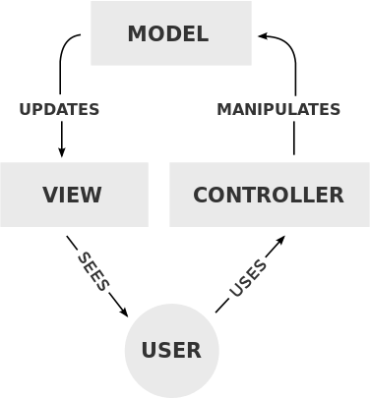
Three-tier web application development (cont’d)
A simple visual representation of MVC is shown in the following diagram:

Slide 8
Introducing MEAN
MEAN is an abbreviation for MongoDB, Express, AngularJS, and Node.js.
The concept behind it is to use only JavaScript-driven solutions to cover the different parts of your application.
The advantages are great and are as follows:
A single language is used throughout the application
All the parts of the application can support and often enforce the use of the MVC architecture
Serialization and deserialization of data structures is no longer needed because data marshaling is done using JSON objects

Slide 9
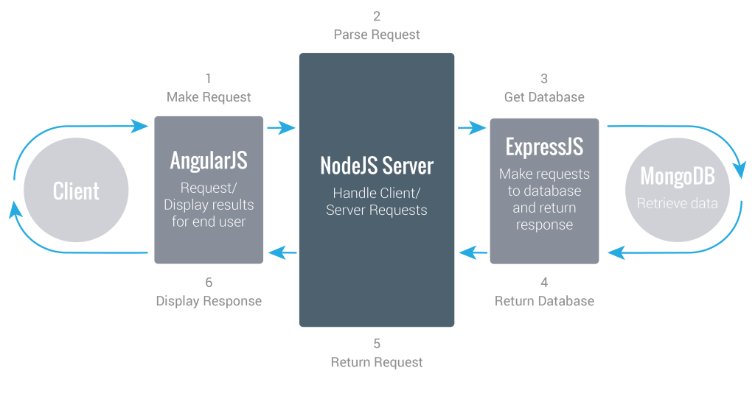
Introducing MEAN (cont’d)
How the MEAN stack fits

Slide 10
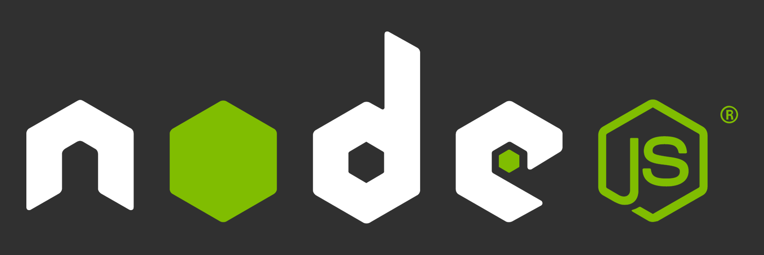
Intro to Node.js

Slide 11
Intro is Node.js
When Google announced Chrome and its new V8 JavaScript engine in late 2008, it was obvious that JavaScript could run faster than before—a lot faster.
V8's greatest advantage over other JavaScript engines was the compiling of JavaScript code to native machine code before executing it.
This and other optimizations made JavaScript a viable programming language capable of executing complex tasks.
Developers decided to try a new idea: non-blocking sockets in JavaScript.
They took the V8 engine, wrapped it with the already solid C code, and created the first version of Node.js.

Slide 12
Intro is Node.js (cont’d)
JavaScript event-driven programming
Node.js uses the event-driven nature of JavaScript to support non-blocking operations in the platform, a feature that enables its excellent efficiency.
JavaScript is an event-driven language, which means that you register code to specific events, and that code will be executed once the event is emitted.
This concept allows you to seamlessly execute asynchronous code without blocking the rest of the program from running.

Slide 13
Introducing NPM
Node.js is a platform, which means its features and APIs are kept to a minimum.
To achieve more complex functionality, it uses a module system that allows you to extend the platform.
The best way to install, update, and remove Node.js modules is using the NPM (Node Package Manager).
NPM has the following main features:
A registry of packages to browse, download, and install third-party modules
A CLI tool to manage local and global packages

Slide 14
Using NPM
Installing a package using NPM
Once you find the right package, you'll be able to install it using the npm install command as follows:
$ npm install <Package Unique Name>
Installing a module globally is similar to its local counterpart, but you'll have to add he –g flag as follows:
$ npm install –g <Package Unique Name>
For example, to locally install Express, you'll need to navigate to your application folder and issue the following command:
$ npm install express

Slide 15
Using NPM (cont’d)
The preceding command will install the latest stable version of the Express package in your local node_modules folder.
Furthermore, NPM supports a wide range of semantic versioning, so to install a specific version of a package, you can use the npm install command as follows:
$ npm install <Package Unique Name>@<Package Version>
For instance, to install the latest major version of the Express package, you'll need to issue the following command:
$ npm install express --save

Slide 16
Using NPM (cont’d)
Removing a package using NPM
To remove an installed package, you'll have to navigate to your application folder and run the following command:
$ npm uninstall < Package Unique Name>
NPM will then look for the package and try to remove it from the local node_modules folder.
To remove a global package, you'll need to use the -g flag as follows:
$ npm uninstall –g < Package Unique Name>

Slide 17
Using NPM (cont’d)
Updating a package using NPM
To update a package to its latest version, issue the following command:
$ npm update < Package Unique Name>
NPM will download and install the latest version of this package even if it doesn’t exist yet.
To update a global package, use the following command:
$ npm update –g < Package Unique Name>

Slide 18
Managing dependencies using the package.json file
Installing a single package is nice, but pretty soon, your application will need to use several packages, and so you'll need a better way to manage these package dependencies.
For this purpose, NPM allows you to use a configuration file named package.json in the root folder of your application.
In your package.json file, you'll be able to define various metadata properties of your application, including properties such as the name, version, and author of your application.
This is also where you define your application dependencies.

Slide 19
Managing dependencies using the package.json file (cont’d)
The package.json file is basically a JSON file that contains the different attributes you'll need to describe your application properties.
An application using the latest Express and Grunt packages will have a package.json file as follows:
{
"name" : "MEAN",
"version" : "0.0.1",
"dependencies" : {
"express" : "latest",
"grunt" : "latest"
}
}

Slide 20
Managing dependencies using the package.json file (cont’d)
Creating a package.json file
While you can manually create a package.json file, an easier approach would be to use the npm init command. To do so, use your command-line tool and issue the following command:
$ npm init
NPM will ask you a few questions about your application and will automatically create a new package.json file for you.
A sample process should look similar to the following screenshot:

Slide 21
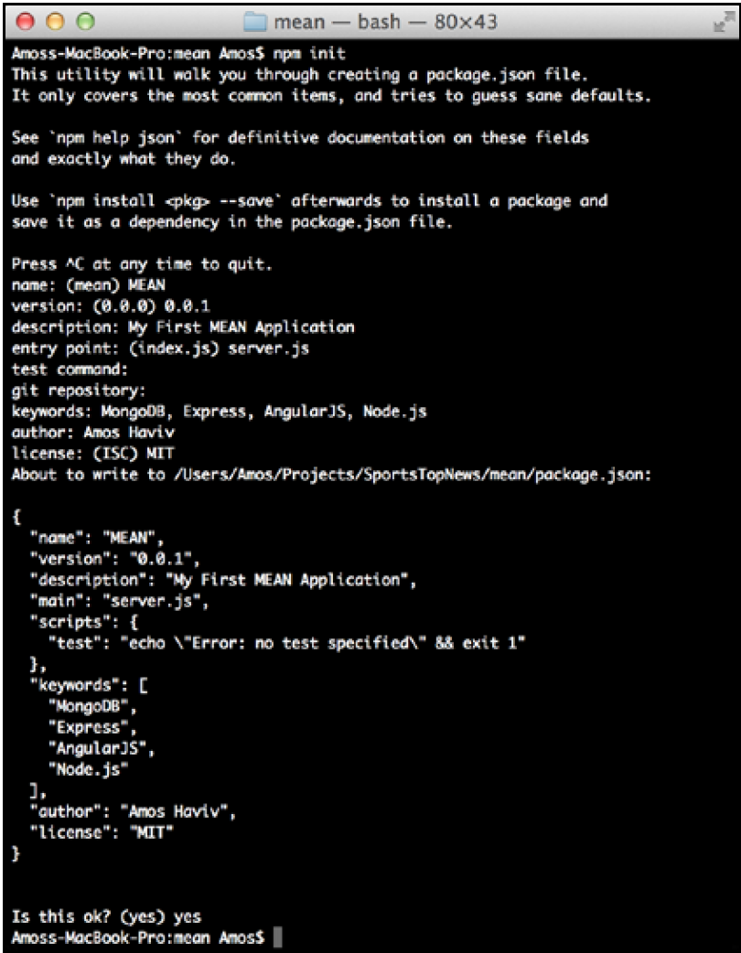
Managing dependencies using the package.json file (cont’d)
A sample process should look similar to the following screenshot:

Slide 22
Managing dependencies using the package.json file (cont’d)
Installing the package.json dependencies
After creating your package.json file, you'll be able to install your application
dependencies by navigating to your application's root folder and using the npm install command as follows:
$ npm install
NPM will automatically detect your package.json file and will install all your application dependencies, placing them under a local node_modules folder.
An alternative and sometimes better approach to install your dependencies is to use the following npm update command:
$ npm update
This will install any missing packages and will update all of your existing dependencies to their specified version.

Slide 23
Managing dependencies using the package.json file (cont’d)
Updating the package.json file
Another robust feature of the npm install command is the ability to install a new package and save the package information as a dependency in your package.json file.
This can be accomplished using the --save optional flag when installing a specific package.
For example, to install the latest version of Express and save it as a dependency, you can issue the following command:
$ npm install express --save

Slide 24
Node Modules
JavaScript has turned out to be a powerful language with some unique features that enable efficient yet maintainable programming.
Its closure pattern and event-driven behavior have proven to be very helpful in real-life scenarios, but like all programming languages, it isn't perfect, and one of its major design flaws is the sharing of a single global namespace.
This could have been a major threat for Node.js evolution as a platform, but luckily a solution was found in the CommonJS modules standard.

Slide 25
CommonJS Modules
CommonJS is a project started in 2009 to standardize the way of working with JavaScript outside the browser.
The project has evolved since then to support a variety of JavaScript issues, including the global namespace issue, which was solved through a simple specification of how to write and include isolated JavaScript modules.
The CommonJS standards specify the following three key components when
working with modules:
require(): This method is used to load the module into your code.
exports: This object is contained in each module and allows you to expose pieces of your code when the module is loaded.
module: This object was originally used to provide metadata information about the module. It also contains the pointer of an exports object as a property. However, the popular implementation of the exports object as a standalone object literally changed the use case of the module object.

Slide 26
CommonJS Modules (cont’d)
In Node's CommonJS module implementation, each module is written in a single JavaScript file and has an isolated scope that holds its own variables.
The author of the module can expose any functionality through the exports object.
To understand it better, let's say we created a module file named hello.js that contains the following code snippet:
var message = 'Hello';
exports.sayHello = function(){
console.log(message);
}

Slide 27
CommonJS Modules (cont’d)
Also, let's say we created an application file named server.js, which contains the following lines of code:
var hello = require('./hello');
hello.sayHello();
In the preceding example, you have the hello module, which contains a variable named message.
The message variable is self-contained in the hello module, which only exposes the sayHello() method by defining it as a property of the exports object.
Then, the application file loads the hello module using the require() method, which will allow it to call the sayHello() method of the hello module.

Slide 28
Node.js Core Modules
Core modules are modules that were compiled into the Node binary.
They come prebundled with Node and are documented in great detail in its documentation.
The core modules provide most of the basic functionalities of Node, including filesystem access, HTTP and HTTPS interfaces, and much more.
To load a core module, you just need to use the require method in your JavaScript file.

Slide 29
Node.js Core Modules (cont’d)
An example code, using the fs core module to read the content of the environment hosts file, would look like the following code snippet:
fs = require('fs');
fs.readFile('/etc/hosts', 'utf8', function (err, data) {
if (err) {
return console.log(err);
}
console.log(data);
});
When you require the fs module, Node will find it in the core modules folder.
You'll then be able to use the fs.readFile() method to read the file's content and print it in the command-line output.

Slide 30
Developing Node.js web applications
Node.js is a platform that supports various types of applications, but the most popular kind is the development of web applications.
Node's style of coding depends on the community to extend the platform through third-party modules; these modules are then built upon to create new modules, and so on.
Companies and single developers around the globe are participating in this process by creating modules that wrap the basic Node APIs and deliver a better starting point for application development.

Slide 31
Developing Node.js web applications (cont’d)
There are many modules to support web application development but none as popular as the Connect module.
The Connect module delivers a set of wrappers around the Node.js low-level APIs to enable the development of rich web application frameworks.

Slide 32
Developing Node.js web applications (cont’d)
To understand what Connect is all about, let's begin with a basic example of a basic Node web server.
In your working folder, create a file named server.js, which contains the following code snippet:
var http = require('http');
http.createServer(function(req, res) {
res.writeHead(200, {
'Content-Type': 'text/plain'
});
res.end('Hello World');
}).listen(3000);
console.log('Server running at http://localhost:3000/');

Slide 33
Developing Node.js web applications (cont’d)
To start your web server, use your command-line tool, and navigate to your working folder.
Then, run the node CLI tool and run the server.js file as follows:
$ node server
Now open http://localhost:3000 in your browser, and you'll see the Hello World response.

Slide 34
Developing Node.js web applications (cont’d)
So how does this work?
In this example, the http module is used to create a small web server listening to the 3000 port.
You begin by requiring the http module and use the createServer() method to return a new server object.
The listen() method is then used to listen to the 3000 port.
Notice the callback function (anonymous function) that is passed as an argument to the createServer() method.

Slide 35
Developing Node.js web applications (cont’d)
The callback function gets called whenever there's an HTTP request sent to the web server.
The server object will then pass the req and res arguments, which contain the information and functionality needed to send back an HTTP response.
The callback function will then do the following two steps:
First, it will call the writeHead() method of the response object. This method is used to set the response HTTP headers. In this example, it will set the Content-Type header value to text/plain. For instance, when responding with HTML, you just need to replace text/plain with html/plain.
Then, it will call the end() method of the response object. This method is used to finalize the response. The end() method takes a single string argument that it will use as the HTTP response body. Another common way of writing this is to add a write() method before the end() method and then call the end() method, as follows:
res.write('Hello World');
res.end();

Slide 36
Meet the Connect module
Connect is a module built to support interception of requests in a more modular approach.
In the first web server example, you learned how to build a simple web server using the http module.
If you wish to extend this example, you'd have to write code that manages the different HTTP requests sent to your server, handles them properly, and responds to each request with the correct response.

Slide 37
Meet the Connect module (cont’d)
Connect creates an API exactly for that purpose – it uses a modular component called middleware, which allows you to simply register your application logic to predefined HTTP request scenarios.
Connect middleware are basically callback functions, which get executed when an HTTP request occurs.
The middleware can then perform some logic, return a response, or call the next registered middleware.
While you will mostly write custom middleware to support your application needs, Connect also includes some common middleware to support logging, static file serving, and more.

Slide 38
Meet the Connect module (cont’d)
The way a Connect application works is by using an object called dispatcher.
The dispatcher object handles each HTTP request received by the server and then decides, in a cascading way, the order of middleware execution.

Slide 39
Meet the Connect module (cont’d)
In the next section, you'll create your first Express application, but Express is based on Connect's approach, so in order to understand how Express works, we'll begin with creating a Connect application.
In your working folder, create a file named server.js that contains the following code snippet:
var connect = require('connect');
var app = connect();
app.listen(3000);
console.log('Server running at http://localhost:3000/');

Slide 40
Meet the Connect module (cont’d)
As you can see, your application file is using the connect module to create a new web server.
However, Connect isn't a core module, so you'll have to install it using NPM.
To do so, use your command-line tool, and navigate to your working folder. Then execute the following command:
$ npm install --save connect
NPM will install the connect module inside a node_modules folder, which will enable you to require it in your application file.
To run your Connect web server, just use Node's CLI and execute the following command:
$ node server

Slide 41
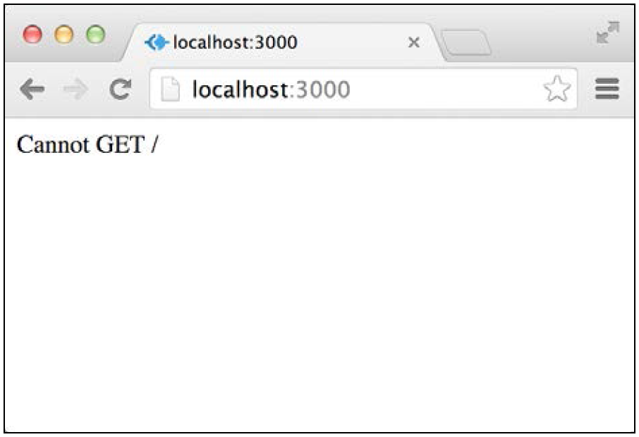
Meet the Connect module (cont’d)
Node will run your application, reporting the server status using the console.log() method.
You can try reaching your application in the browser by visiting http:// localhost:3000.
However, you should get a response similar to what is shown in the following screenshot:
What this response means is that there isn't any middleware registered to handle the GET HTTP request.

Slide 42
Connect Middleware
Connect middleware is just JavaScript function with a unique signature.
Each middleware function is defined with the following three arguments:
req: This is an object that holds the HTTP request information
res: This is an object that holds the HTTP response information and allows you to set the response properties
next: This is the next middleware function defined in the ordered set of Connect middleware

Slide 43
Connect Middleware (cont’d)
When you have a middleware defined, you'll just have to register it with the Connect application using the app.use() method.
Let's revise the previous example to include your first middleware.
Change your server.js file to look like the following code snippet:
var connect = require('connect');
var app = connect();
var helloWorld = function(req, res, next) {
res.setHeader('Content-Type', 'text/plain');
res.end('Hello World');
};
app.use(helloWorld);
app.listen(3000);
console.log('Server running at http://localhost:3000/');

Slide 44
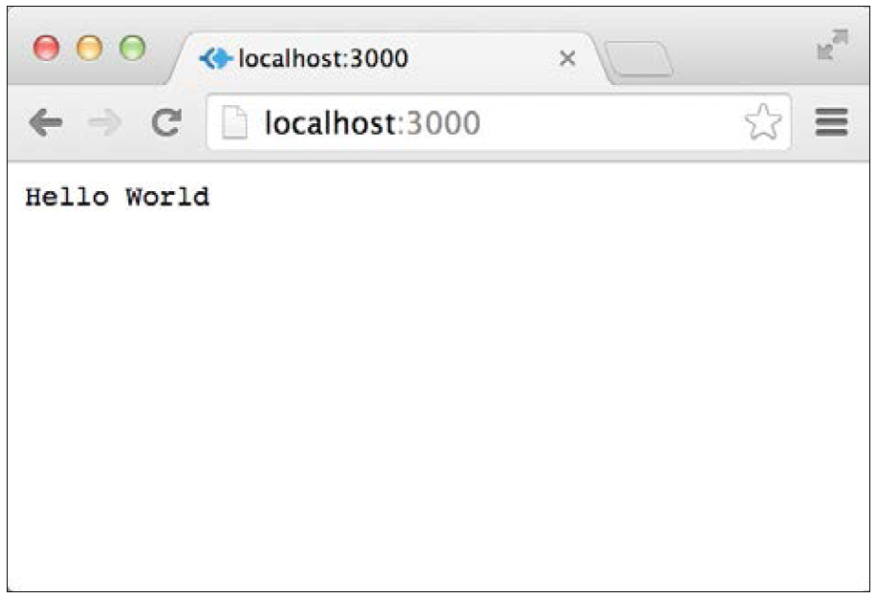
Connect Middleware (cont’d)
Then, start your connect server again by issuing the following command in your command-line tool:
$ node server
Try visiting http://localhost:3000 again.
You will now get a response similar to that in the following screenshot:

Slide 45
Mounting Connect middleware
As you may have noticed, the middleware you registered responds to any request regardless of the request path.
This does not comply with modern web application development because responding to different paths is an integral part of all web applications.
Fortunately, Connect middleware supports a feature called mounting, which enables you to determine which request path is required for the middleware function to get executed.
Mounting is done by adding the path argument to the app.use() method.
To understand this better, let's revisit our previous example.

Slide 46
Mounting Connect middleware (cont’d)
To understand this better, let's revisit our previous example -- modify your server.js file to look like the following code snippet:
var connect = require('connect');
var app = connect();
var logger = function(req, res, next) {
console.log(req.method, req.url);
next();
};
var helloWorld = function(req, res, next) {
res.setHeader('Content-Type', 'text/plain');
res.end('Hello World');
};
var goodbyeWorld = function(req, res, next) {
res.setHeader('Content-Type', 'text/plain');
res.end('Goodbye World');
};
app.use(logger);
app.use('/hello', helloWorld);
app.use('/goodbye', goodbyeWorld);
app.listen(3000);
console.log('Server running at http://localhost:3000/');

